Slide 1
Magical Moving Pictures
Oscar Owl’s
Compiled by Fiona Gately, 2013.
Oscar Owl Image: clker.com

Slide 2
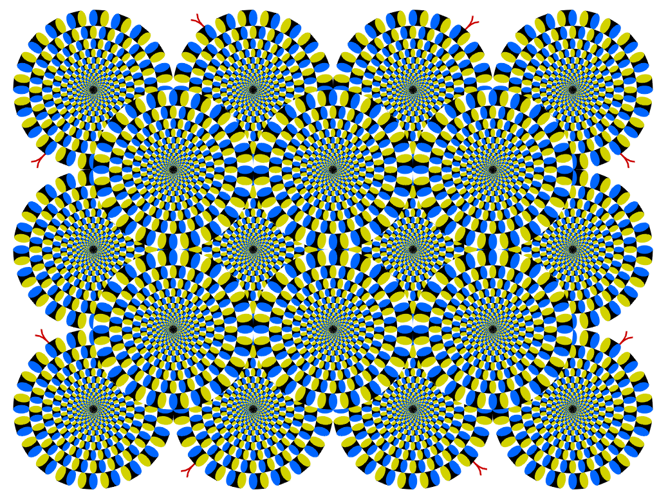
http://www.ritsumei.ac.jp/~akitaoka/index-e.html

Slide 3
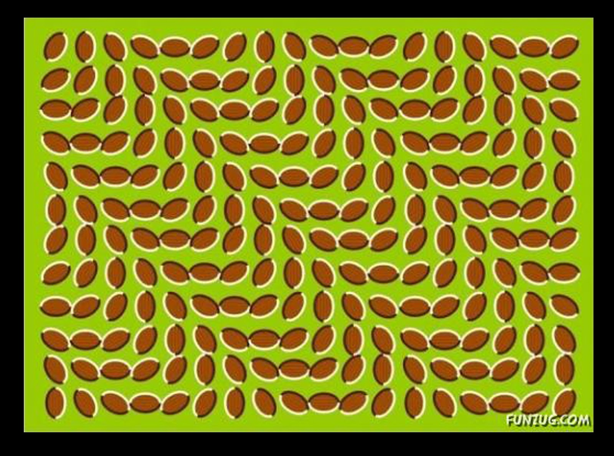
http://thilankawitharana.blogspot.com.au/

Slide 4
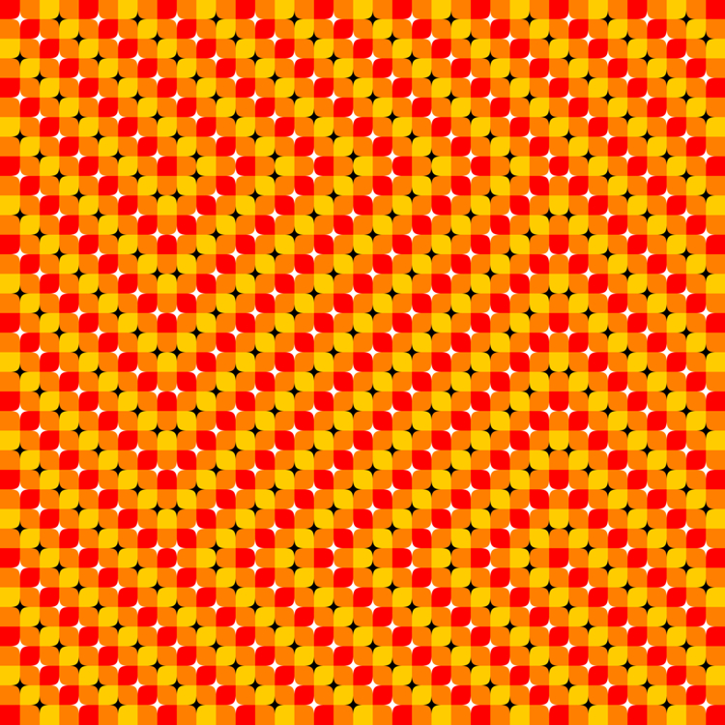
http://vi.sualize.us/optical_01_mighty_orange_patterns_optical_illusions_picture_6QM1.html

Slide 5
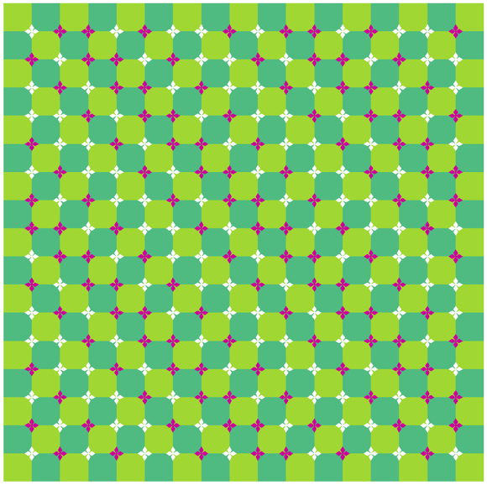
http://wirelessroadwarrior.blogspot.com.au/2008/01/optical-illusions.html

Slide 6
http://www.excelhero.com/blog/2010/05/excel-optical-illusions-12.html

Slide 7
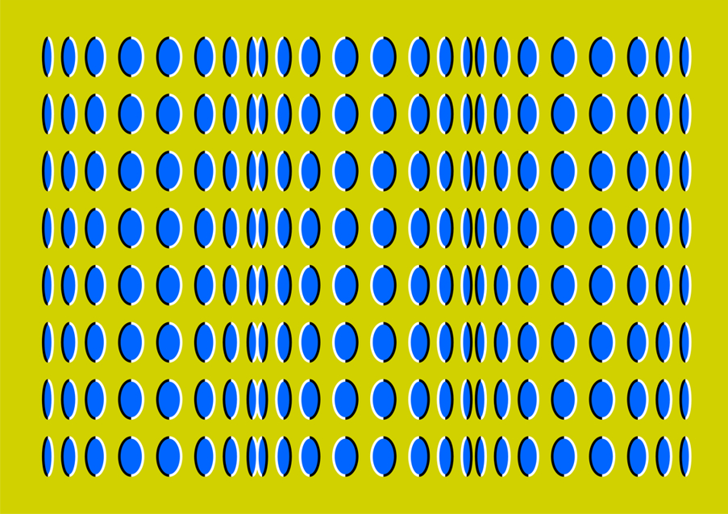
http://www.smscs.com/photo/optical_illusions_wallpaper.html

Slide 8
http://www.ritsumei.ac.jp/kic/~akitaoka/index-e.html

Slide 9
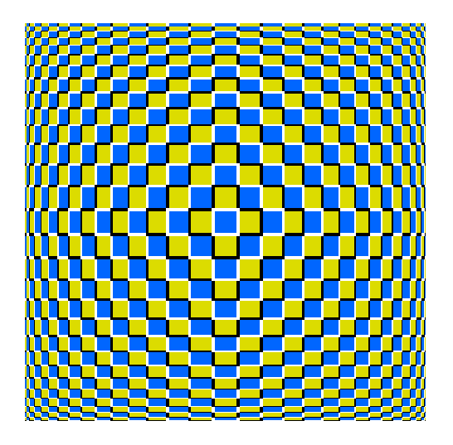
http://www.psy.ritsumei.ac.jp/~akitaoka/expcushe.html

Slide 10
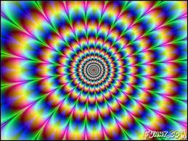
http://www.smscs.com/photo/optical_illusions_wallpaper.html

Slide 11
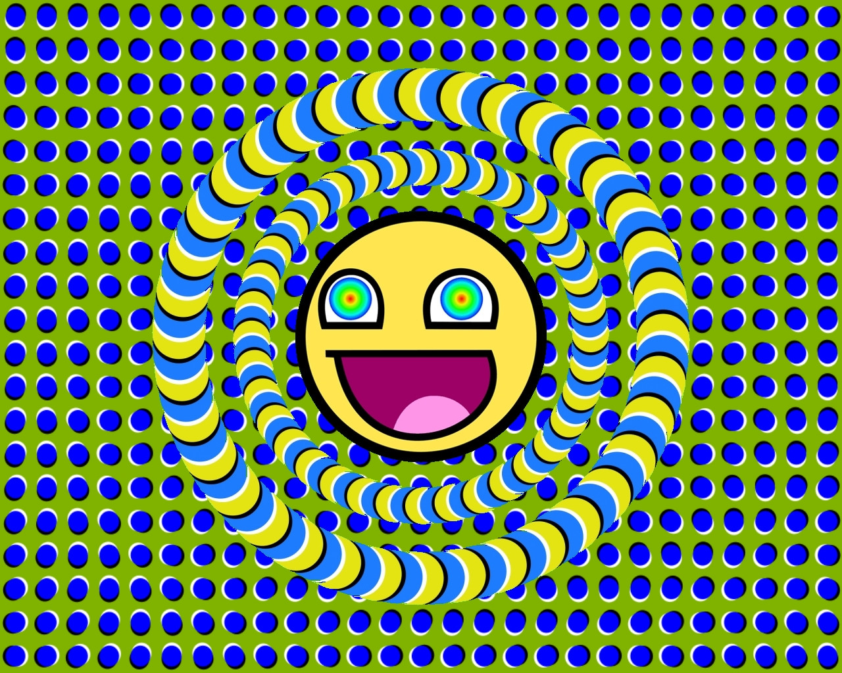
Fayfreethinkers.com

Slide 12
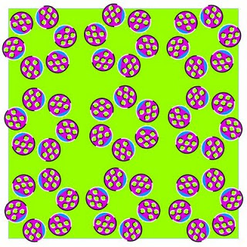
Opticalillusions99.blogspot.com

Slide 13
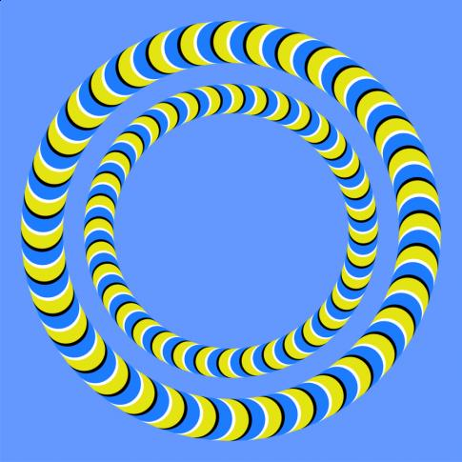
Kidspace.com

Slide 14
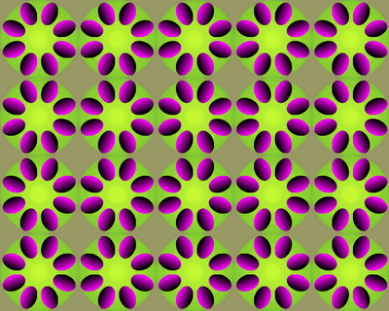
Voillusions.blogspot.com

Slide 15
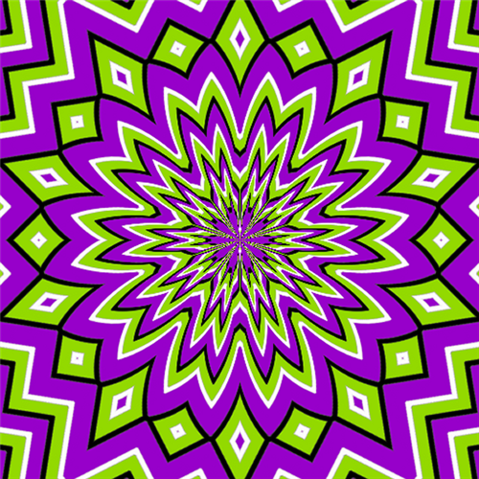
Forestville.com

Slide 16
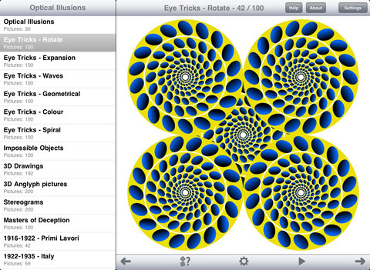
http://appfinder.lisisoft.com/app/1500+-optical-illusions-hd.html

Slide 17
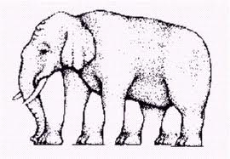
Oscar Owl wants to trick you now!
Thinkoutsidethebox.com
See if you can count the elephant’s legs!

